Slide 1


Generative AI for Student Research
lib.uvic.ca/gen-ai
By the UVic Libraries
Digital Scholarship Commons
askus@uvic.ca
lib.uvic.ca/dsc/
Notes:
Lesson Plan and Activities: https://lib.uvic.ca/gen-ai

Slide 2
Outline
Introductory presentation: 25-min
A cautionary tale
Generative AI overview
AI-powered tools for research
Limitations & reliability
Responsible & ethical use
Active learning time with AI tools: 65-min

Slide 3
Have you used ChatGPT? (or any other Generative AI tool)
What is your current skill level with Generative AI tools?
Basic
Intermediate
Advanced

Slide 4
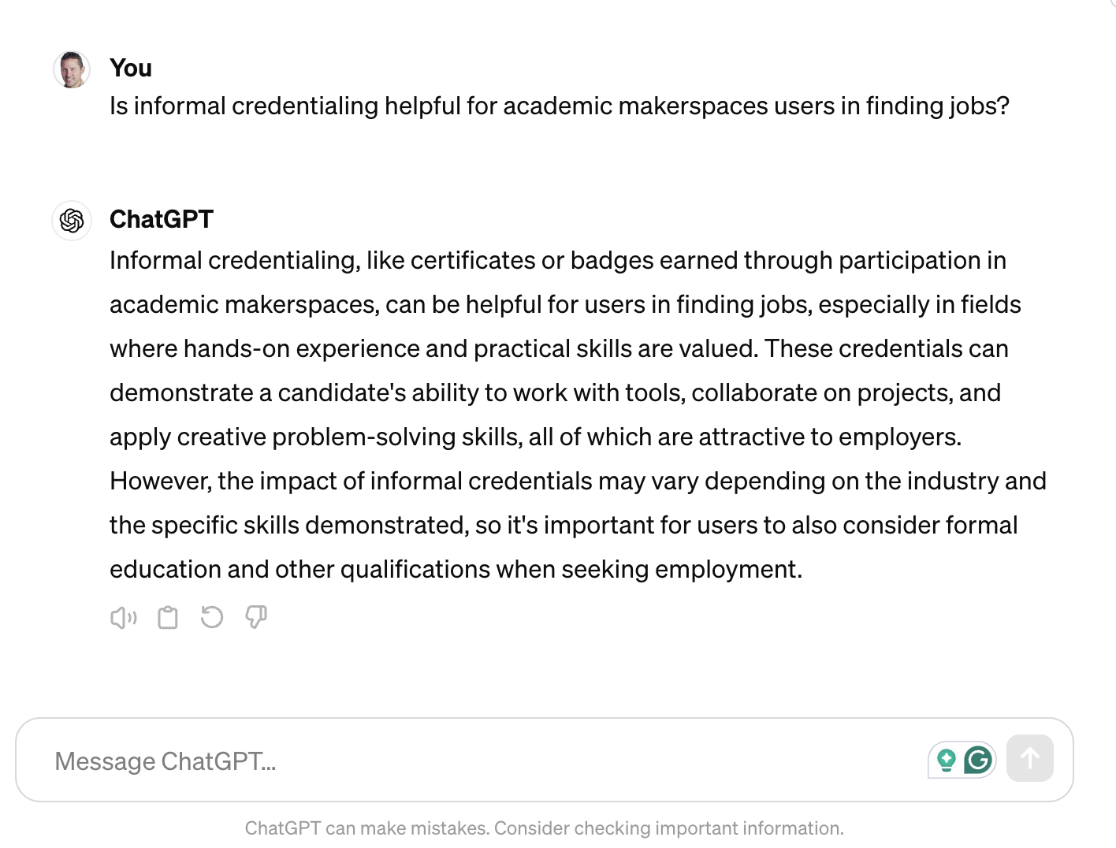
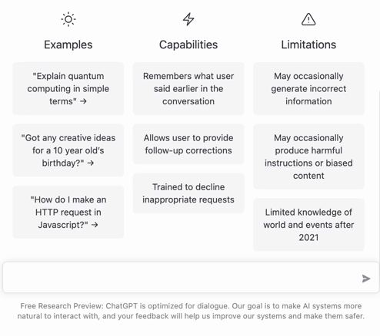
A First Attempt
Notes:
Does Generative AI work?
Sometimes is works very well!
This is the very first thing one our staff asked ChatGPT back in December 2022, and they were shocked at how good the answer was!
ChatGPT (Dec 2022)

Slide 5
But…

Slide 6
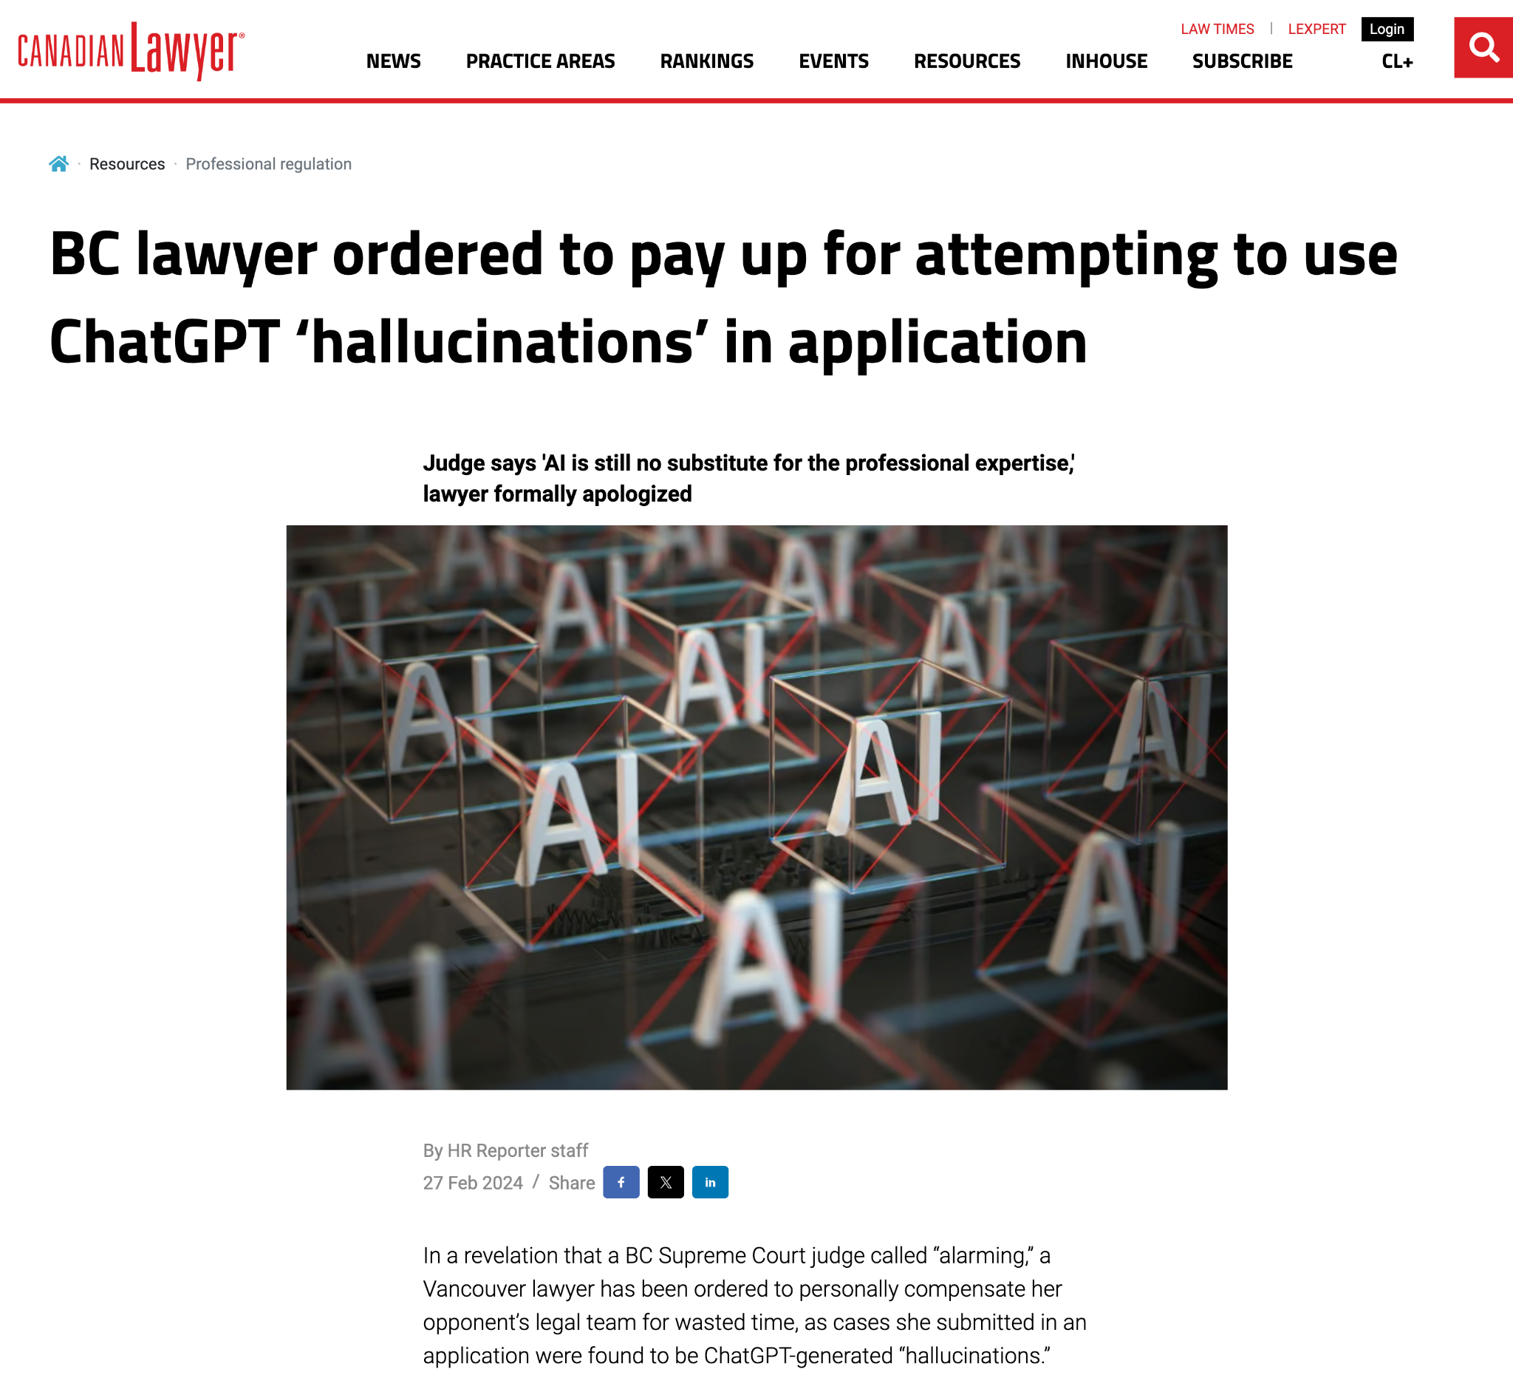
GenAI Sometimes Makes Stuff Up…
Notes:
Sometimes it can be much less accurate and cause real problems.
Vancouver lawyer had to personally compensate her opponent’s legal team for wasted time, as cases she submitted in an application were found to be ChatGPT-generated “hallucinations.”
Source: https://www.canadianlawyermag.com/resources/professional-regulation/bc-lawyer-ordered-to-pay-up-for-attempting-to-use-chatgpt-hallucinations-in-application/384023

Slide 7
An overview of
Artificial Intelligence

Slide 8

ChatGPT is NOT
Intelligent!
“ChatGPT has no intelligence. Any statements it makes are liable to be false. It can't avoid that because it doesn't know what the words mean.”
- Richard Stallman (2023)
https://www.reddit.com/r/linux/comments/122gmm9/richard_stallmans_thoughts_on_chatgpt_artificial/
Notes:
ChatGPT is NOT intelligent, and the same is true with other large language model GenAI tools.
Source: https://www.reddit.com/r/linux/comments/122gmm9/richard_stallmans_thoughts_on_chatgpt_artificial/

Slide 9
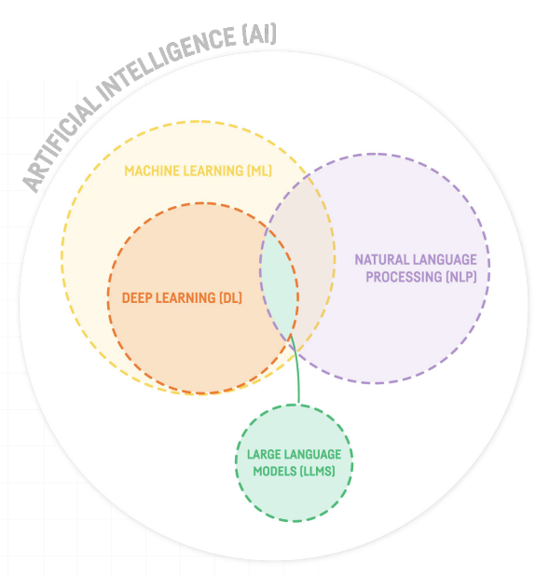




NARROW
https://blog.dataiku.com/large-language-model-chatgpt
Notes:
This diagram helps us situate where Generative AI lives in the larger Artificial Intelligence ecosystem.
[NEXT] Large Language Models power a lot of what the GenAI does for us in a Research setting
[NEXT] ChatGPT, Microsoft CoPilot, & Google Gemini are the most popular general purpose Generative AI tools that we see regularly in the media.
But as we will discuss in a minute, there are other AI tools much better suited to help us with our research.
For Reference Purposes:
Narrow Artificial Intelligence: Computer systems able to perform specific tasks, with a limited scope of functionality normally requiring human intelligence
Machine Learning: Gives computers the ability to learn without being explicitly programmed, with feedback from humans (Google Photos image recognition)
Deep Learning: Machine learning algorithms (learner and instructor algorithms) that can “learn” without human feedback (ChatGPT, Google’s Go player, etc.) -> GAN or Generative Adversarial Networks
Natural Language Processing (NLP): Focuson on enabling computers to understand, interpret and generate human language.
https://blog.dataiku.com/large-language-model-chatgpt

Slide 10
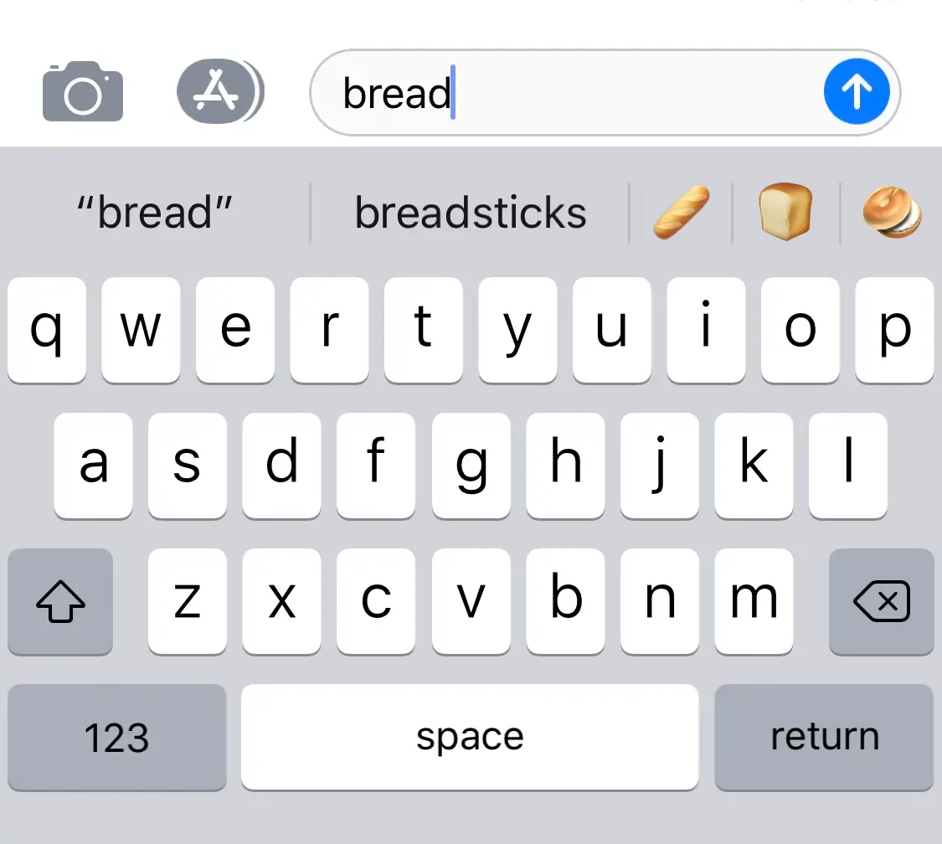
Notes:
We have all been using Generative AI for quite a while now…
Starting with writing on your phone which sometimes helpfully completes words your start to type as well as the next word before you start typing it.

Slide 11
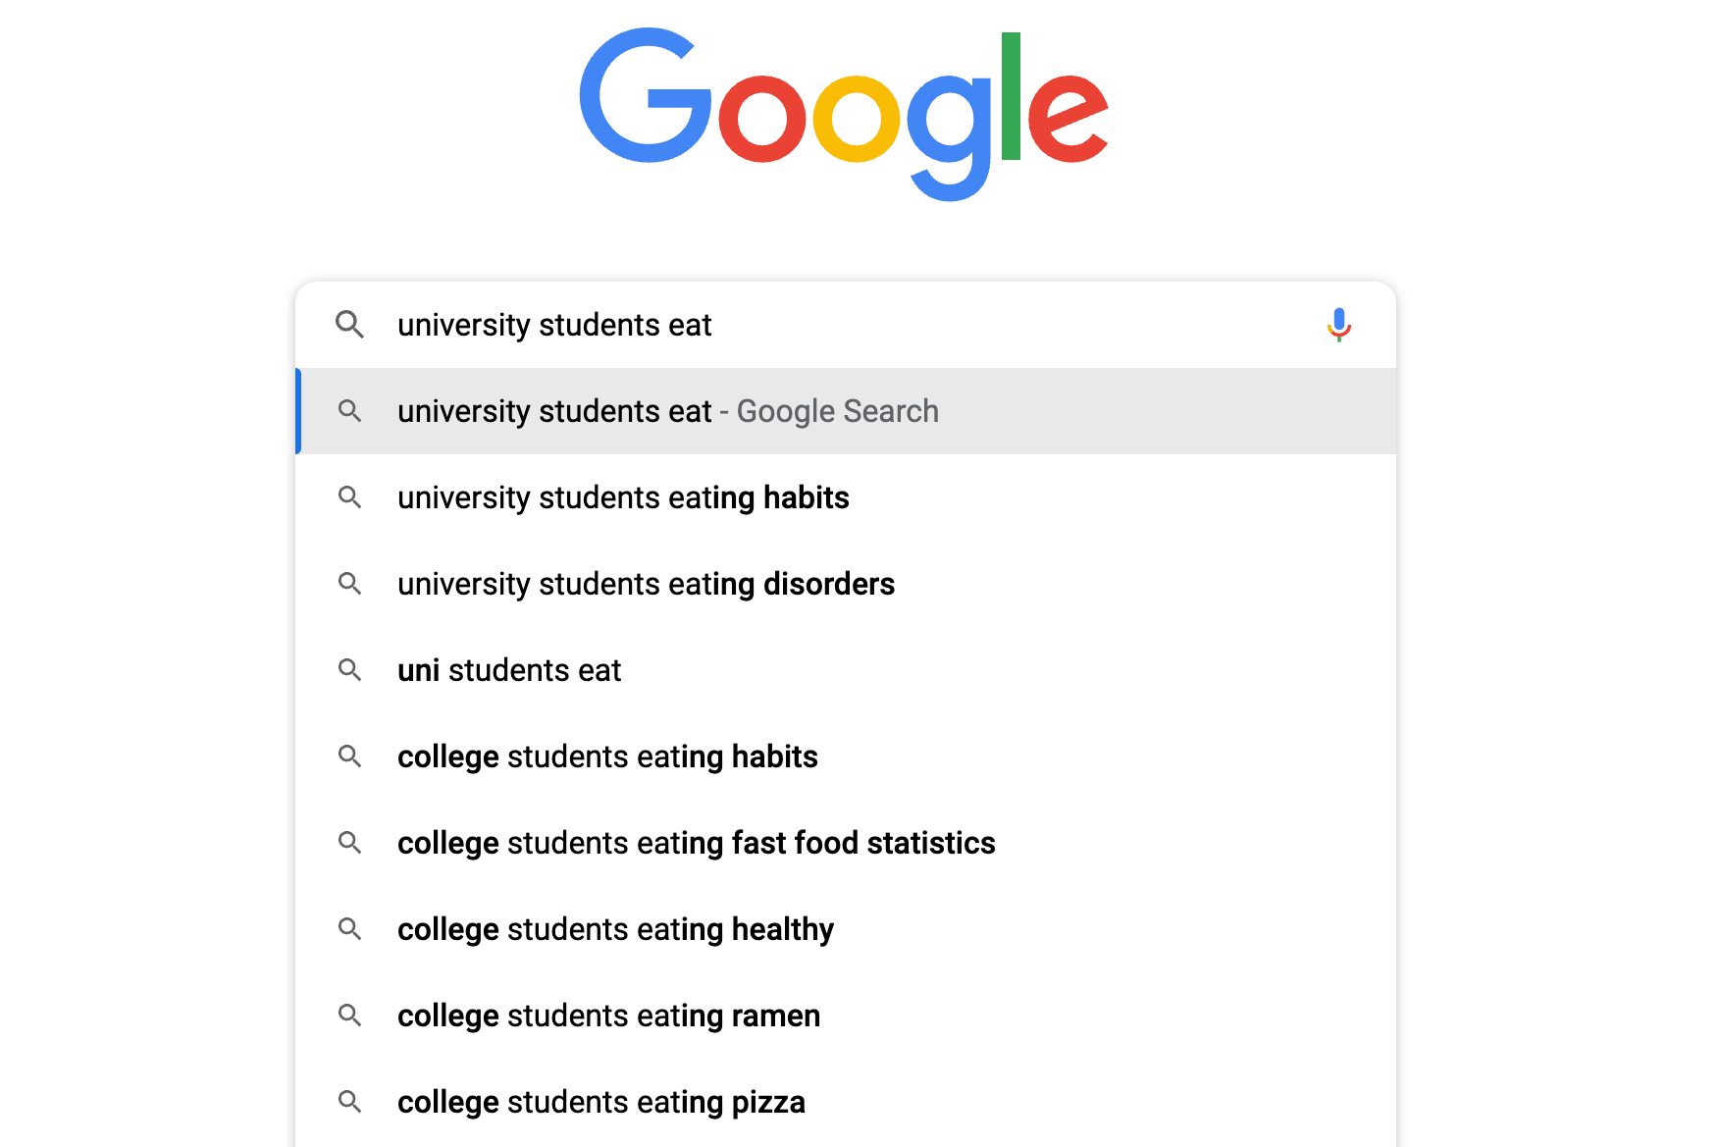
Notes:
Google search is another common GenAI tool

Slide 12
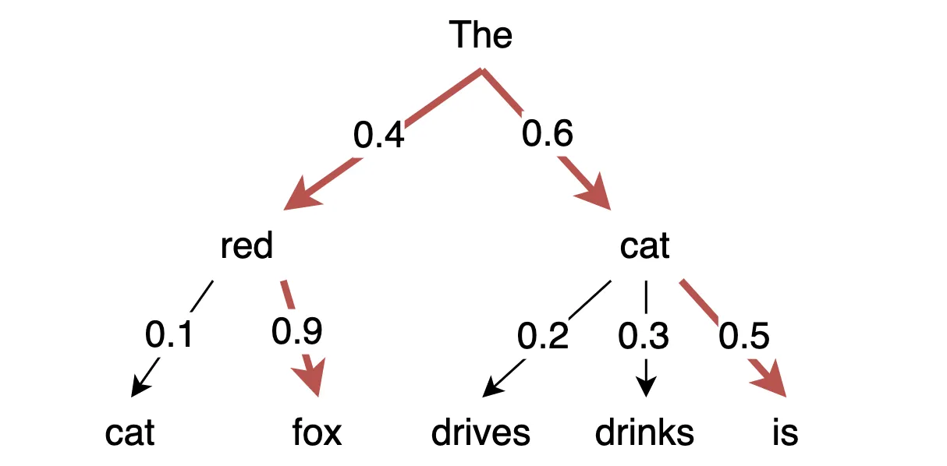
https://medium.com/nlplanet/two-minutes-nlp-most-used-decoding-methods-for-language-models-9d44b2375612
Notes:
This diagram is an oversimplification, but at it’s core this is generally speaking what Generative Large Language Models do…
They predict what word or sentence comes next using statistical models and HUGE, HUBE data sets.

Slide 13

Generative AI at work…
Like an Overeager
Intern that Sometimes
Makes Stuff Up!
OpenAI. (2024). ChatGPT (4) [Large language model]. https://chat.openai.com
Notes:
Unfortunately currently general purpose GenAI like ChatGPT are a lot like overeager and overconfident interns…
Who will makeup plausible sounding responses, including fake quotes from experts in a field & fake citations in order to fulfill your request.
Image credit: OpenAI. (2024). ChatGPT (4) [Large language model]. https://chat.openai.com

Slide 14

Can I Use GenAI for My Research Assignments?

Slide 15
Does My Professor Allow the Use of GenAI?

Slide 16
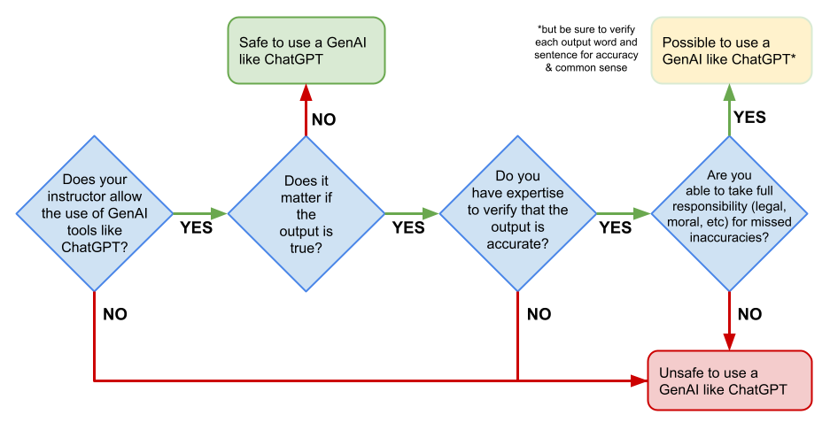
Can I use GenAI for this assignment?
Based on the UNESCO AI in higher education flow chart (CC-BY-SA)
Notes:
Can you use GenAI (or LLM) for the assignment?
[NEXT] First, does your professor allow it?
If so, what uses are permitted? Eg:
Brainstorming
Literature review
Do you have the expertise to evaluate the GenAI outputs for accuracy?
Are you able to take full responsibility for any missed inaccuracies?
Source (CC-BY-SA licensed): https://www.iesalc.unesco.org/wp-content/uploads/2023/04/ChatGPT-and-Artificial-Intelligence-in-higher-education-Quick-Start-guide_EN_FINAL.pdf

Slide 17
Potential GenAI uses for research:
Brainstorming
Topic exploration
Literature review
Research question formulation
Writing assistance
Each different use of GenAI need to be specifically permitted by your Instructor.
Notes:
Potential GenAI uses for research:
Brainstorming
Topic exploration
Literature review
Research question formulation
Writing assistance
[NEXT]
Each different use of GenAI need to be specifically permitted by your Instructor…
In my experience most instructors will not permit GenAI use for Writing Assistance.

Slide 18
GenAI Literature Review Tools
Notes:
Fortunately there are more reliable AI powered tools built specifically for researchers…

Slide 19
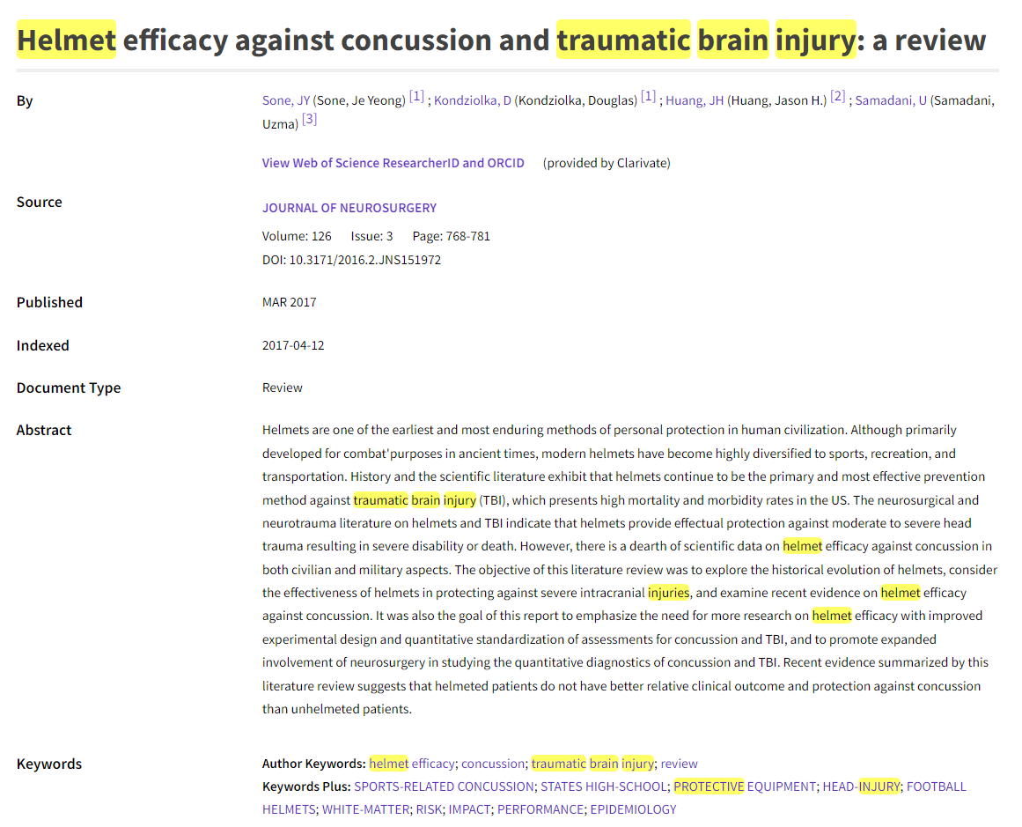
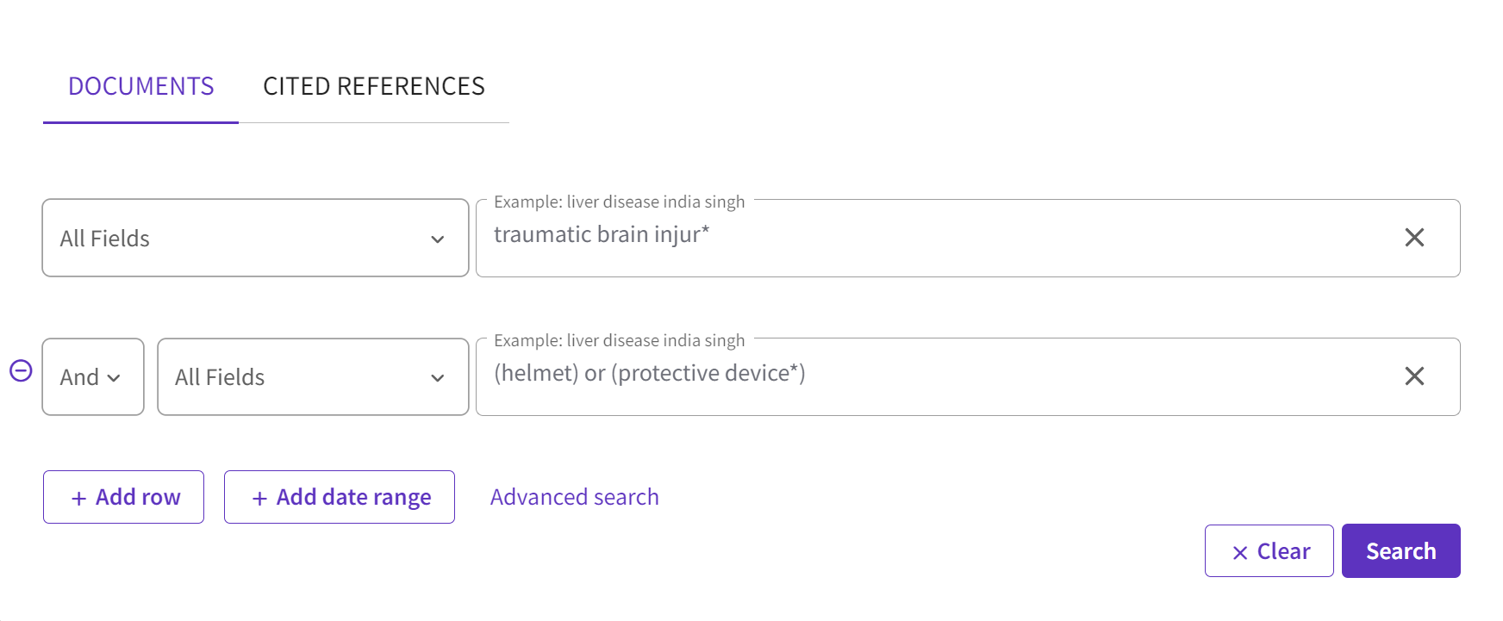
Traditional research search tools…
Slide credit: Scott Cowan MLIS, Roger Reka MI, Leddy Library at the University of Windsor
Notes:
Traditional Library search engines search collections of millions of peer reviewed articles & books.
[NEXT]
They then allow to to do keyword searches
Slide credit: Scott Cowan MLIS, Roger Reka MI, Leddy Library at the University of Windsor

Slide 20
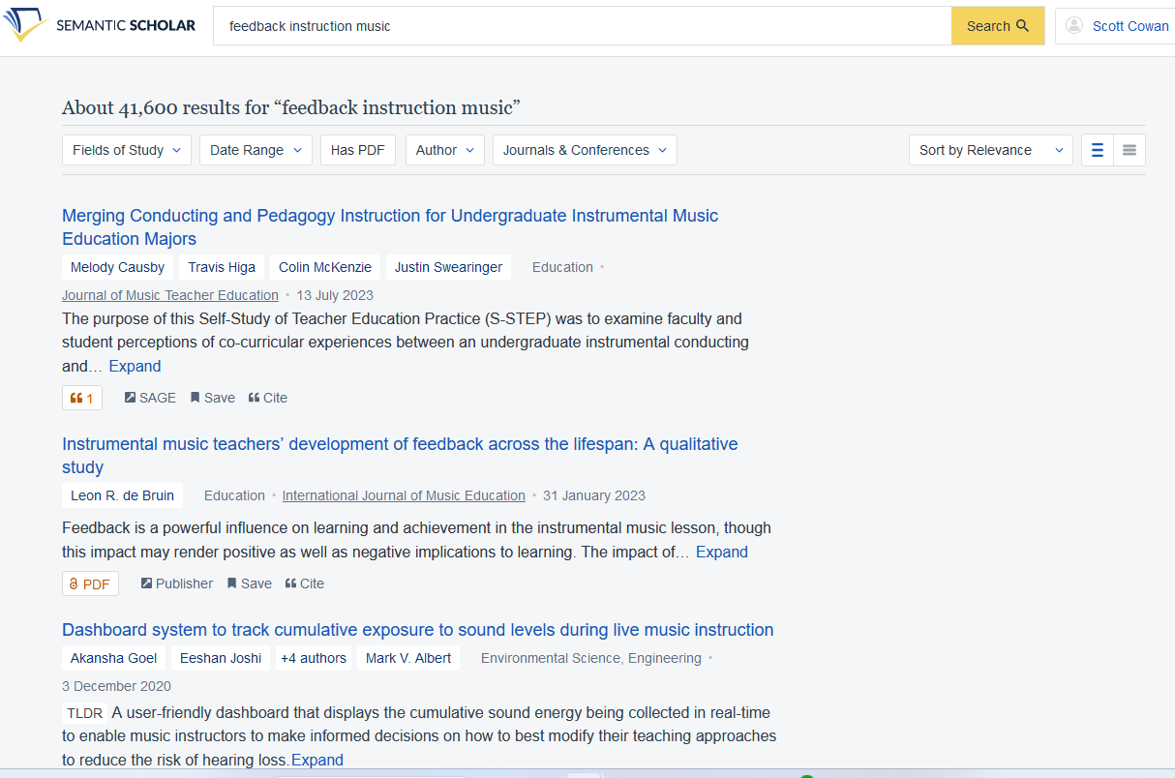
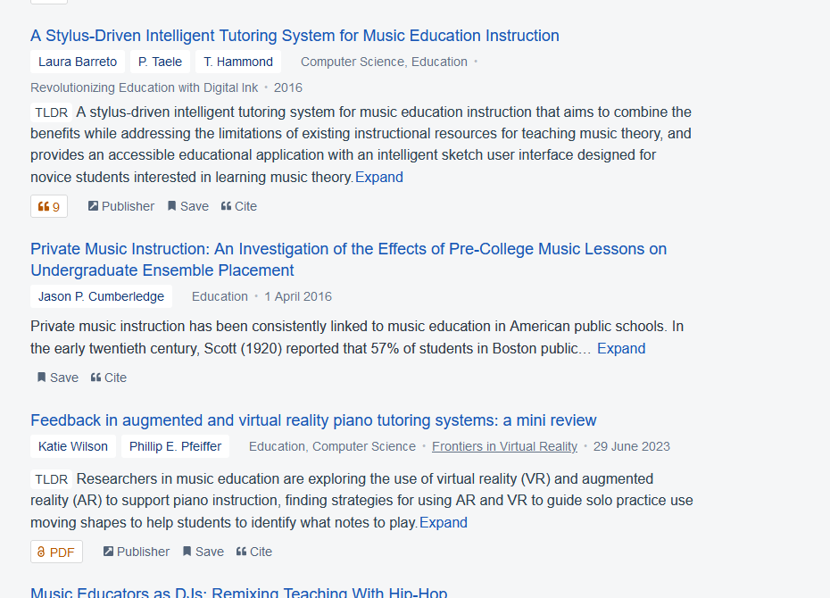
Semantic Scholar: GenAI Article Summaries
Still keyword searches only
Slide credit: Scott Cowan MLIS, Roger Reka MI, Leddy Library at the University of Windsor
Notes:
With Semantic scholar you still do keyword searches, but it uses GenAI to create summaries of journal articles
Don’t depend on the summaries!
They are typically better than general GenAI tools but can still “make stuff up”
Slide credit: Scott Cowan MLIS, Roger Reka MI, Leddy Library at the University of Windsor

Slide 21
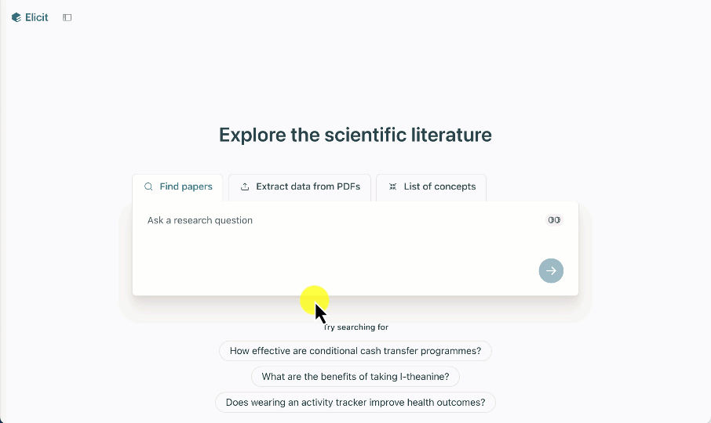
Elicit: Summaries of Top 4 Articles
Notes:
Elicit allows you to use natural language prompts and it uses GenAI to create summaries of the content of the top 4 articles it finds.
Don’t depend on the summaries!
They are typically better than general GenAI tools but can still “make stuff up”

Slide 22
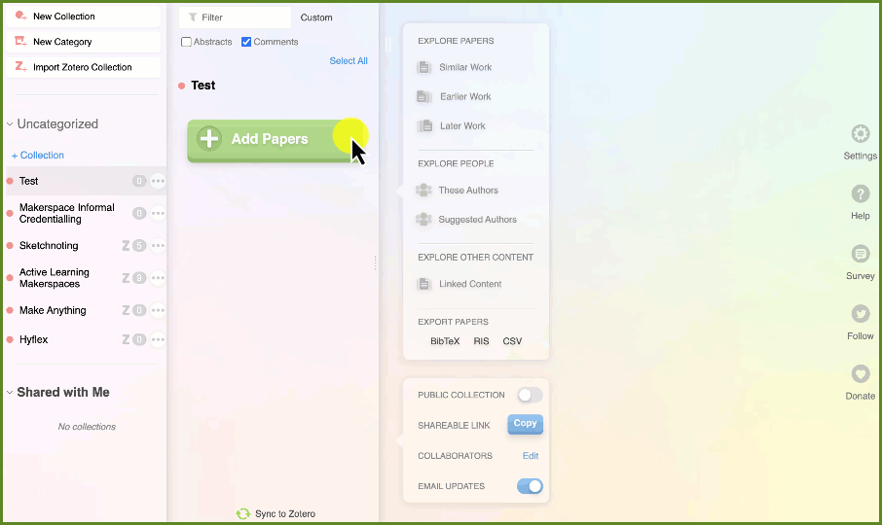
Research Rabbit: Visualize Networks
Still keyword searches only
Notes:
Research Rabbit allows you use keyword searches, or you can make connections with the articles you already have found, with other similar articles.
It also creates article summaries
Don’t depend on the summaries!
They are typically better than general GenAI tools but can still “make stuff up”

Slide 23

What about ChatGPT & other general GenAI tools?
Trained on a massive, primarily non-academic text datasets
Prone to hallucinations and errors -. Out of 115 generated references:
47% fabricated
46% authentic but inaccurate
Bhattacharyya, M., Miller, V. M., Bhattacharyya, D. & Miller, L. E. High rates of fabricated and inaccurate references in ChatGPT-Generated medical content. Cureus 15, e39238 (2023).
Slide credit: Scott Cowan MLIS, Roger Reka MI, Leddy Library at the University of Windsor
Notes:
ChatGPT is not suitable for literature searching at all!
It only has access to OpenAccess academic literature, and not to journal articles and books behind paywalls
It is prone to hallucinations and errors when generating academic literature references
AND they all SOUND genuine!!!
Does not provide sources or references to the information it generates.
Slide credit: Scott Cowan MLIS, Roger Reka MI, Leddy Library at the University of Windsor

Slide 24
Citing GenAI Tools

Slide 25



How to cite AI tools:
Your professor may give you specific instructions on how to cite GenAI created or assisted work for their class.
Always follow your instructor’s instructions!
Source: Christian Schmidt, University of Victoria Libraries
Notes:
Source: Christian Schmidt, University of Victoria Libraries

Slide 26
Citing AI tools if you don’t have guidance from your instructor:
Save a transcript of your chat (including prompts)
Include the date of your transcript
Include the chat transcript as an appendix to your work
Acknowledge how you used the tool (even if you only use GenAI to plan a paper or brainstorm)
Cite using the Style Used in your academic discipline (e.g. Education uses APA & Engineering uses IEEE)
Notes:
Source: Christian Schmidt, University of Victoria Libraries

Slide 27
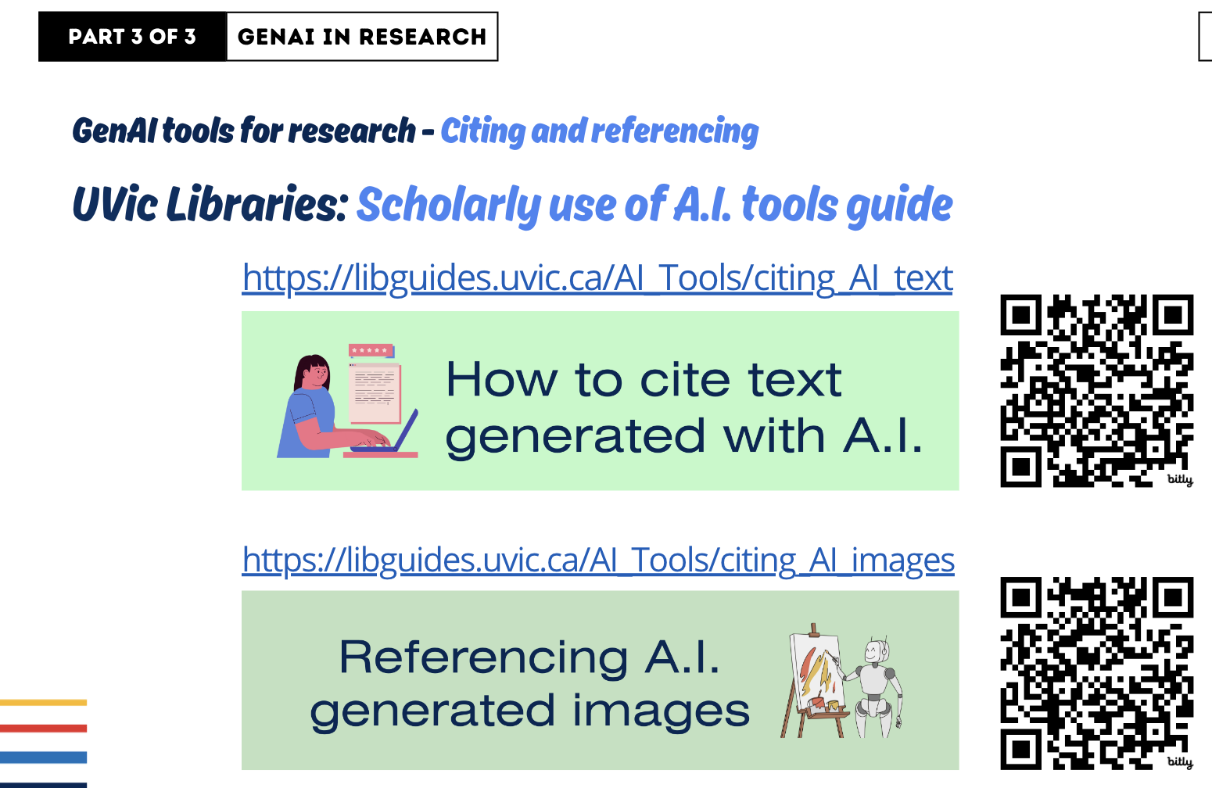
Source: Christian Schmidt, University of Victoria Libraries
Notes:
How to cite GenAI text & images:
Citing GenAI text: https://libguides.uvic.ca/AI_Tools/citing_AI_text
Citing GenAI images: https://libguides.uvic.ca/AI_Tools/citing_AI_images
Source: Christian Schmidt, University of Victoria Libraries

Slide 28
Limitations & reliability
Notes:
Let’s talk a bit about GenAI limitations & reliability…

Slide 29
GenAI Data sources
Semantic Scholar
(also what Elicit uses)
Free and freemium AI-powered tools rely on Open Access data sources, web scraping, or direct-source
Varying degrees of depth for the data: Full-text -OR- Basic metadata
Web scraping (incl. Open Access data)
Indexing agreements with 50 publishers*
ResearchRabbit
Microsoft Academic Graph
Slide credit: Scott Cowan MLIS, Roger Reka MI, Leddy Library at the University of Windsor
Notes:
It is important to consider the source of the data that these AI apps have been trained on, as not all are equal
Free and freemium apps have access to different types of data, depending on their business model including:
Open Access data
Web scraping
Semantic Scholar uses:
Web scraping primarily, so the data isn’t necessarily consistent and clean
And it gets data directly from 50 publishers -- but no Elsevier
ResearchRabbit uses
Just Microsoft Academic Graph (but is no longer maintained)
Slide credit: Scott Cowan MLIS, Roger Reka MI, Leddy Library at the University of Windsor

Slide 30

Bias in, bias out
Biased data
Language models are trained to identify patterns in datasets
Large-scale Generative AI display racial and gender biases in their datasets (the internet is the primary training data for non-academic GenAI tools)⁶
Biases in academic literature:
Global North
English-language
AI tool
Biased response
⁶Zhou, Mi, et al. Bias in Generative AI. arXiv:2403.02726, arXiv, 5 Mar. 2024. arXiv.org, https://doi.org/10.48550/arXiv.2403.02726.
Slide credit: Scott Cowan MLIS, Roger Reka MI, Leddy Library at the University of Windsor
Notes:
Reminder on how these tools work: they are trained to identify patterns in data;
So, it is only as good as the data
One of the main limitations of Generative AI is that it reproduces biases from the information and data it is trained on.
[NEXT]
For example, here is DALL-E’s response to the prompt: “A Portrait of Chief Executives”
Any biases that appear with the academic literature, will likely also appear in AI-generated responses
For example, the overrepresentation of publications from the Global North, or the English-language
Slide credit: Scott Cowan MLIS, Roger Reka MI, Leddy Library at the University of Windsor

Slide 31
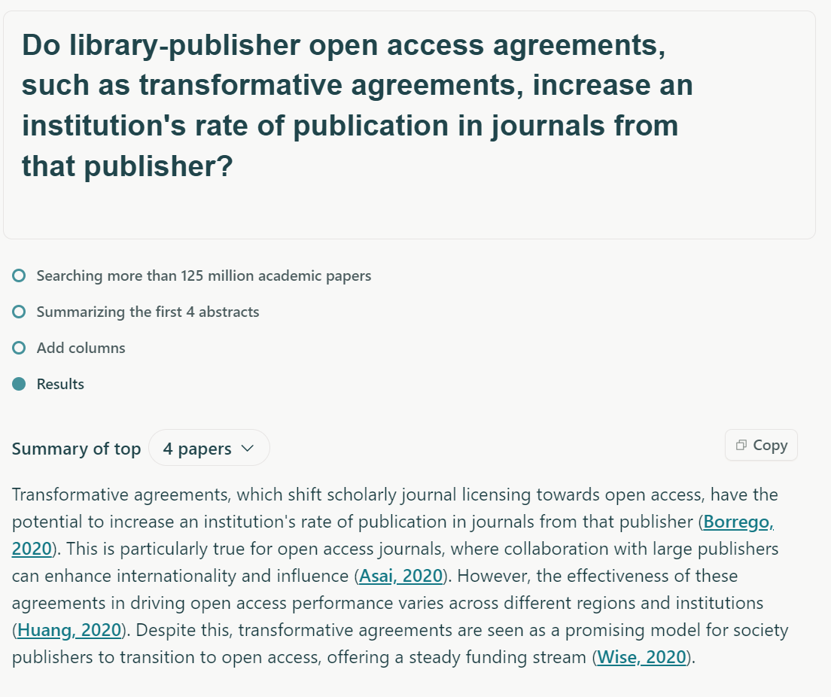
Summaries
GenAI regularly just makes things up⁷
Do not rely on summaries -- read & summarize on your own
⁷“What Are AI Hallucinations?” Google Cloud, https://cloud.google.com/discover/what-are-ai-hallucinations.
Slide credit: Scott Cowan MLIS, Roger Reka MI, Leddy Library at the University of Windsor
Notes:
This is an example of Elicit using a real citation, but making up false information about publishing rates that were not in the article.
CLICK:
This was an example of a hallucination:
AI hallucinations are incorrect or misleading results that AI models generate
In the case of text-generations, such as summaries, it means that you can get good-sounding summaries that are actually incorrect
Slide credit: Scott Cowan MLIS, Roger Reka MI, Leddy Library at the University of Windsor

Slide 32
From Elicit:
“Language models, while extraordinarily powerful, aren't trained to be truth-seeking and are prone to generating false claims about a given source text (i.e., hallucinating).”⁸
⁸Factored Verification: Detecting and Reducing Hallucinations in Frontier Models Using AI Supervision.” Elicit Blog, 20 Oct. 2023, https://blog.elicit.com/factored-verification-detecting-and-reducing-hallucinations-in-frontier-models-using-ai-supervision/
Slide credit: Scott Cowan MLIS, Roger Reka MI, Leddy Library at the University of Windsor
Notes:
Don’t just take my word on it, hear it from Elicit themselves
Need to be critical of generated summaries and extractions of data from these AI tools
Check the sources…supervise the AI bot
Slide credit: Scott Cowan MLIS, Roger Reka MI, Leddy Library at the University of Windsor

Slide 33
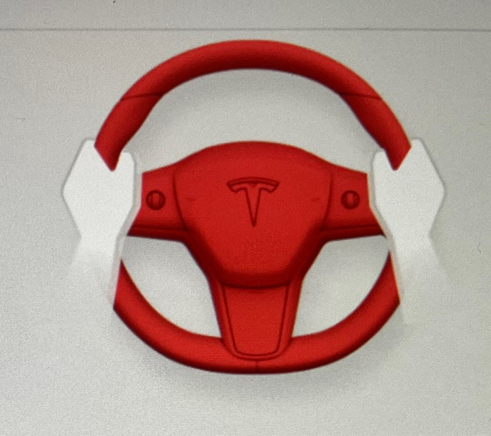
Tesla’s Full Self Driving “See-Saw”
Problem with AI
Powered Bug
Fixes…

Slide 34
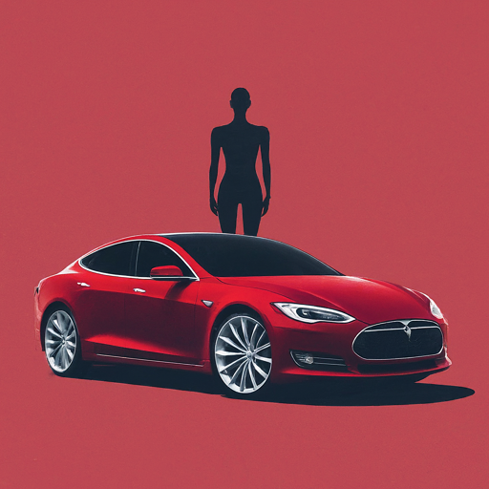
Tesla’s Solution: Shadow Test of AI Generated Bug Fixes on Non-FSD Tesla Vehicles to See How
They Perform Against
Human Drivers

Slide 35
Responsible and ethical use

Slide 36
Considerations when using AI for literature searching
Selecting a tool
What data was the AI trained on?
What are the capabilities & limits of the tool?
Critiquing responses
Check responses for hallucinations. Read source materials!!!!
Use in combination with traditional academic search tools
Slide credit: Scott Cowan MLIS, Roger Reka MI, Leddy Library at the University of Windsor
Notes:
Considerations for literature searching
Selecting a tool:
What data was the AI trained on?
How does it use AI?
What are the capabilities and limits?
Freemium: Pricing limitations
Response limites: Eg: Elicit -> 400 responses
Critiquing responses:
Check all responses for hallucinations before accepting them: Read source materials
[NEXT]
MOST IMPORTANTLY:
These tools are not a replacement for humans with literature searching.
When using them, supervise their use and critique the generated responses
Not a replacement for traditional indexes

Slide 37
Ethical use in courses
Using GenAI tools, to create and pass work off as your own is academic misconduct
Check with instructor on the acceptable use of GenAI in the course
You must supervise GenAI you use!!!
!
Slide credit: Scott Cowan MLIS, Roger Reka MI, Leddy Library at the University of Windsor
Notes:
Check with instructor on the acceptable use of AI in the course
The use of any tool, including generative AI, to create and pass work off as your own is academic misconduct
Supervised use in support of other literature searching techniques

Slide 38
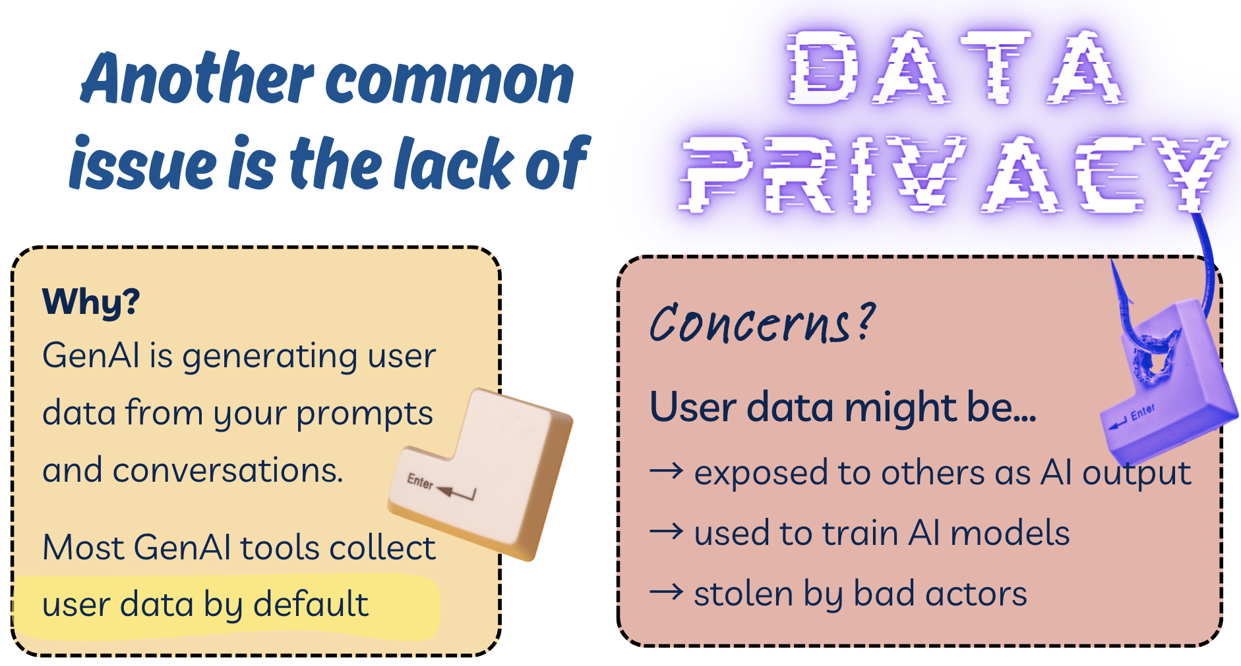
Slide credit: Christian Schmidt, University of Victoria Libraries
Notes:
Slide credit: Christian Schmidt, University of Victoria Libraries

Slide 39
What to Learn More?

Slide 40
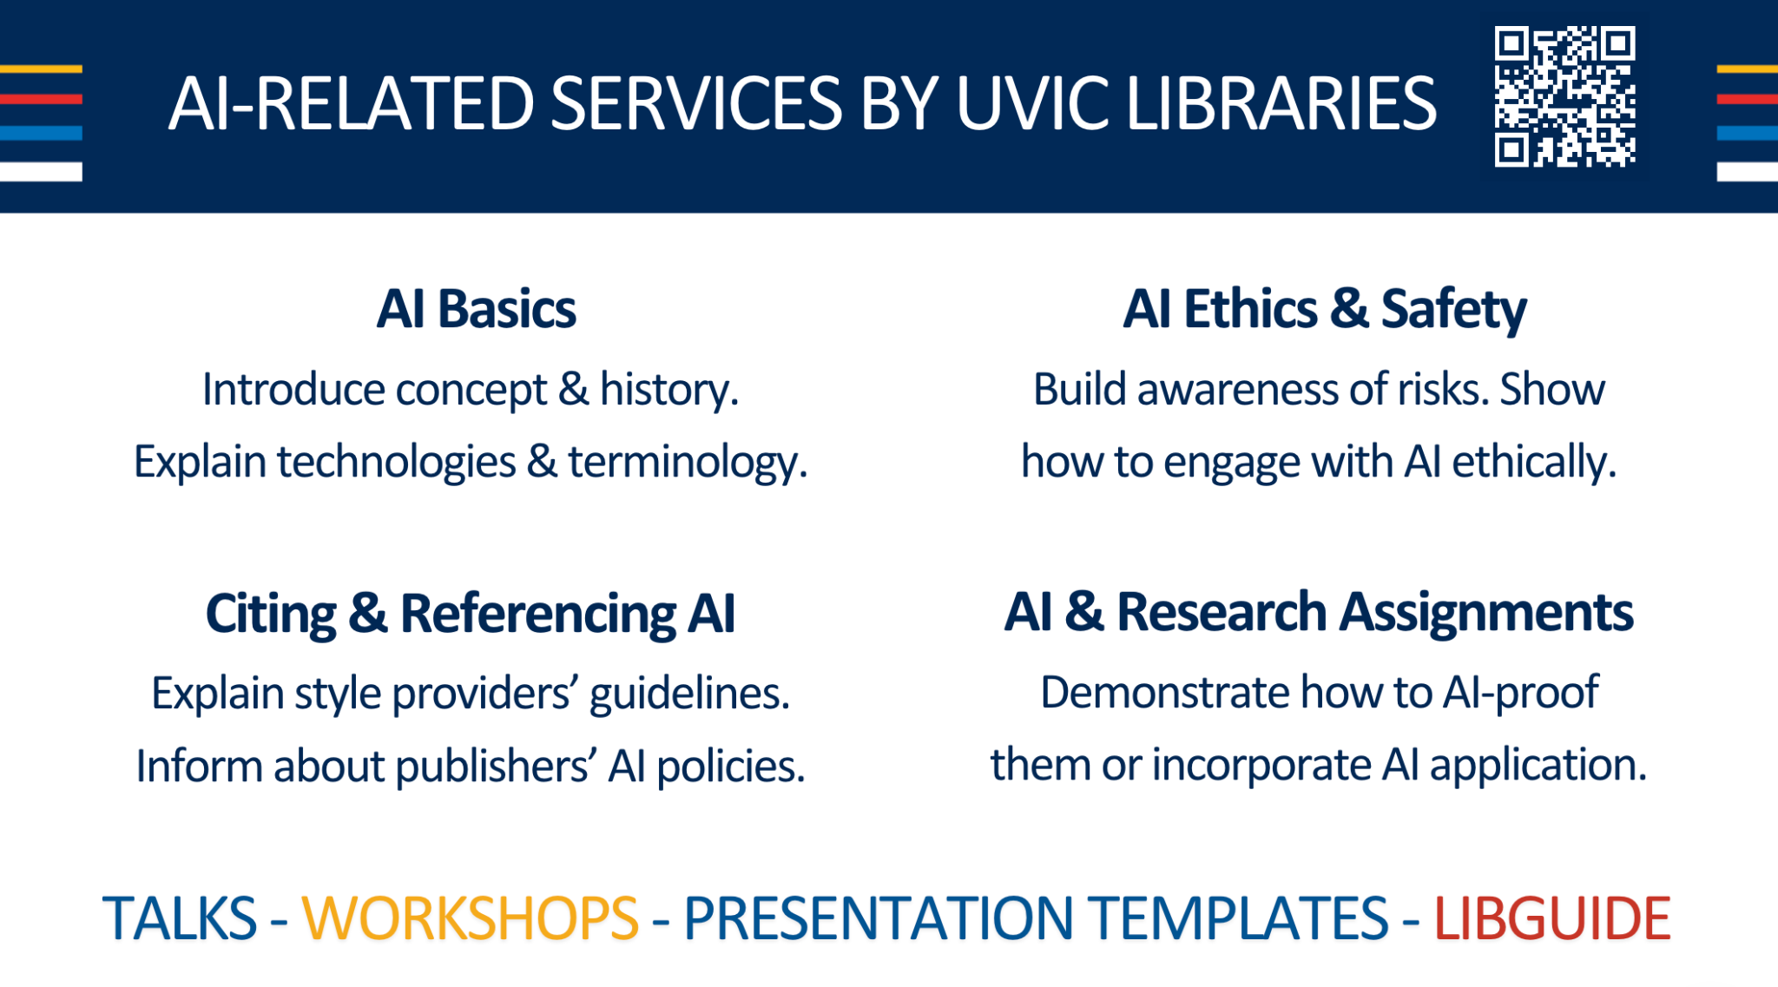
Slide credit: Christian Schmidt, University of Victoria Libraries
Notes:
Slide credit: Slide credit: Christian Schmidt, University of Victoria Libraries

Slide 41
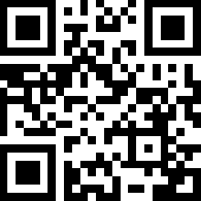
UVic Libraries Can Help You!
lib.uvic.ca/ai-cite
Notes:
https://lib.uvic.ca/ai-cite

Slide 42

Let’s Practice Using GenAI Tools…
Notes:
So let’s try to use some of the new tools we’ve been talking about to make a more persuasive presentation!

Slide 43

Active Learning Time!
Today’s Activities: lib.uvic.ca/gen-ai
For questions later:
askus@uvic.ca
Notes:
https://lib.uvic.ca/gen-ai

